Slide 1
VISA APPROVAL PREDICTION Using Machine Learning Smart Bridge-Remote Summer Internship Program
Developed by: Vivek Gupta
Darshan Gondakar
Niranjan S
Dhanush G Pattanashetti
Syed Maaz

Slide 2
TABLE OF CONTENTS
Introduction
Purpose
Block Diagram
Process Flow
Flow Chart
Software Designing
Experimental Investigation
Advantages and Disadvantages
Conclusion

Slide 3
INTRODUCTION
In our project, we aim to predict the outcome of H-1B visa applications that are ﬁled by many high-skilled foreign nationals every year. We framed the problem as a classiﬁcation problem and applied Naive Bayes, SVM in order to output a predicted case status of the application. The input to our algorithm is the attributes of the applicant which will be further explained in the following parts.
H-1B is a type of non-immigrant visa in the United States that allows foreign nationals to work in occupations that require specialized knowledge and a bachelor’s degree or higher in the speciﬁc specialty [1]. This visa requires the applicant to have a job oﬀer from an employer in the US before they can ﬁle an application to the US immigration service (USCIS). USCIS grants 85,000 H-1B visas every year, even though the number of applicants far exceed that number [2]. The selection process is claimed to be based on a lottery, hence how the attributes of the applicants aﬀect the ﬁnal outcome is unclear. We believe that this prediction algorithm could be a useful resource both for the future H-1B visa applicants and the employers who are considering to sponsor them.

Slide 4
PURPOSE
Our aim from the project is to make use of pandas, matplotlib , & seaborn libraries from python to extract the libraries for machine learning for the Visa prediction.
Secondly, to learn how to hyper tune the parameters using grid search cross validation for the Naïve Bayes machine learning algorithm.
And in the end, to predict whether the Visa applicant can replay the Visa or not using voting ensemble techniques of combining the predictions from multiple machine learning algorithms and withdrawing the conclusions.

Slide 5
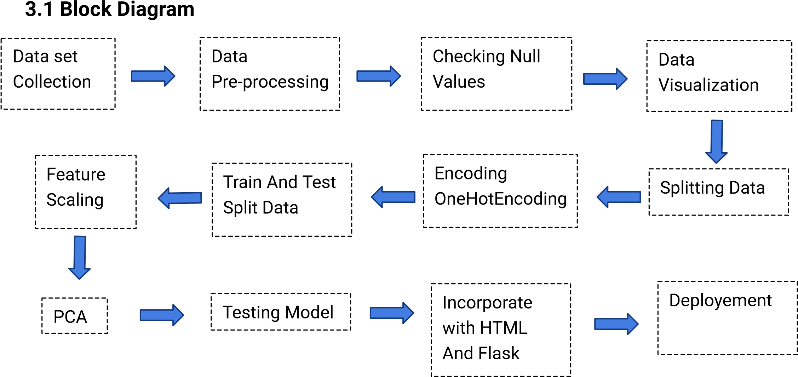
BLOCK DIAGRAM

Slide 6
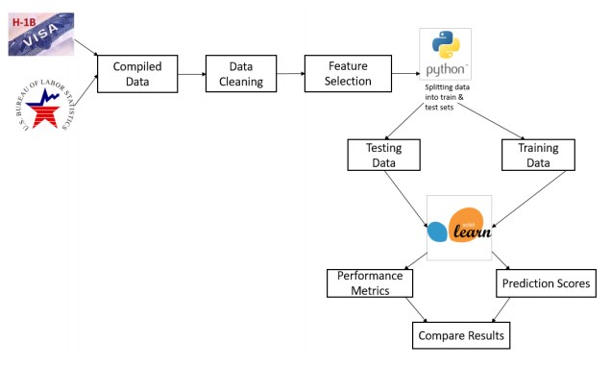
PROCESS FLOW

Slide 7
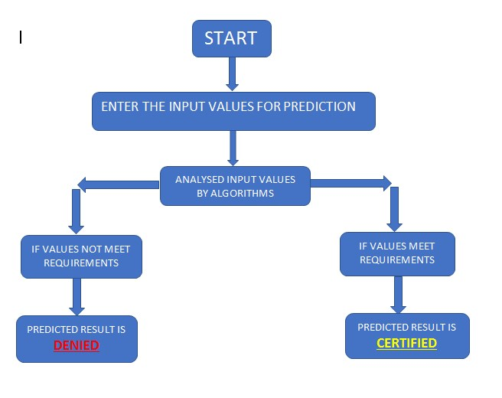
FLOW CHART

Slide 8
SOFTWARE DESIGNING
● Jupyter Notebook Environment.
● Machine Learning Algorithms.
● Python Web Frame Works , Python For Data Analysis
We developed this forest fire prediction by using the Python language which is a interpreted and high level programming language and using the Machine Learning algorithms. for coding we used the Jupyter Notebook environment of the Anaconda distributions, it is an integrated scientific programming in the python language.

Slide 9
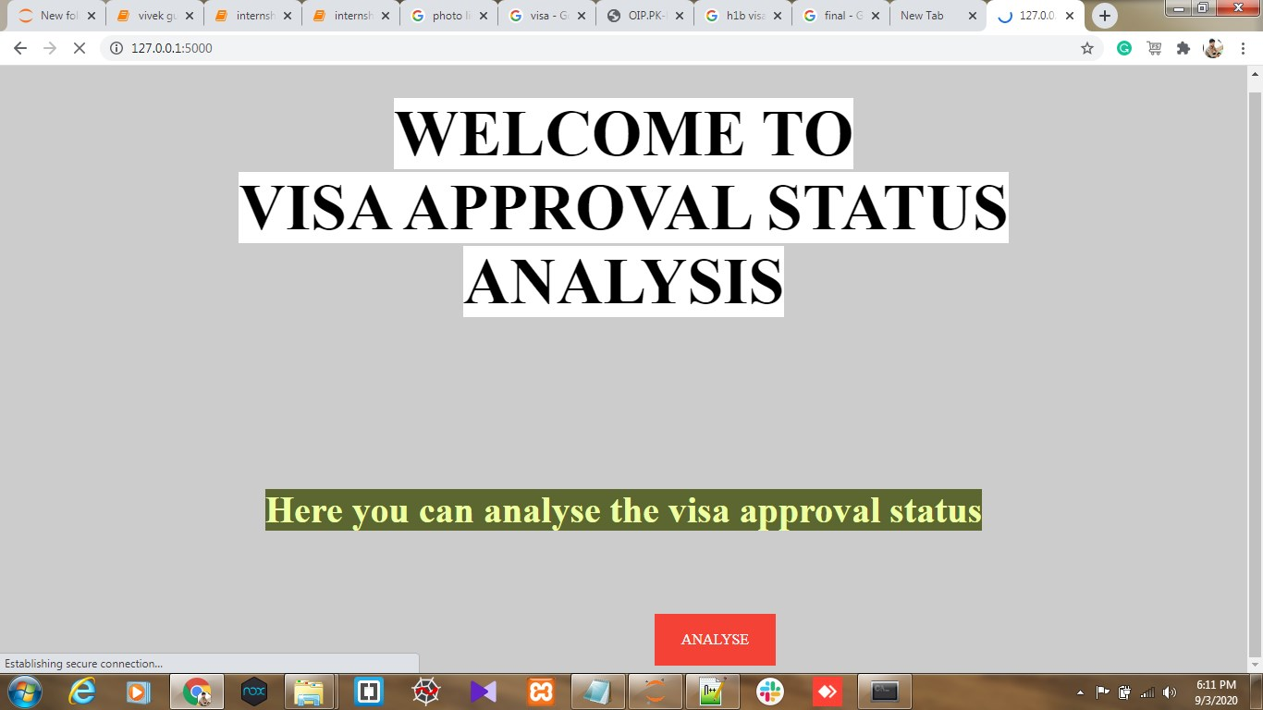
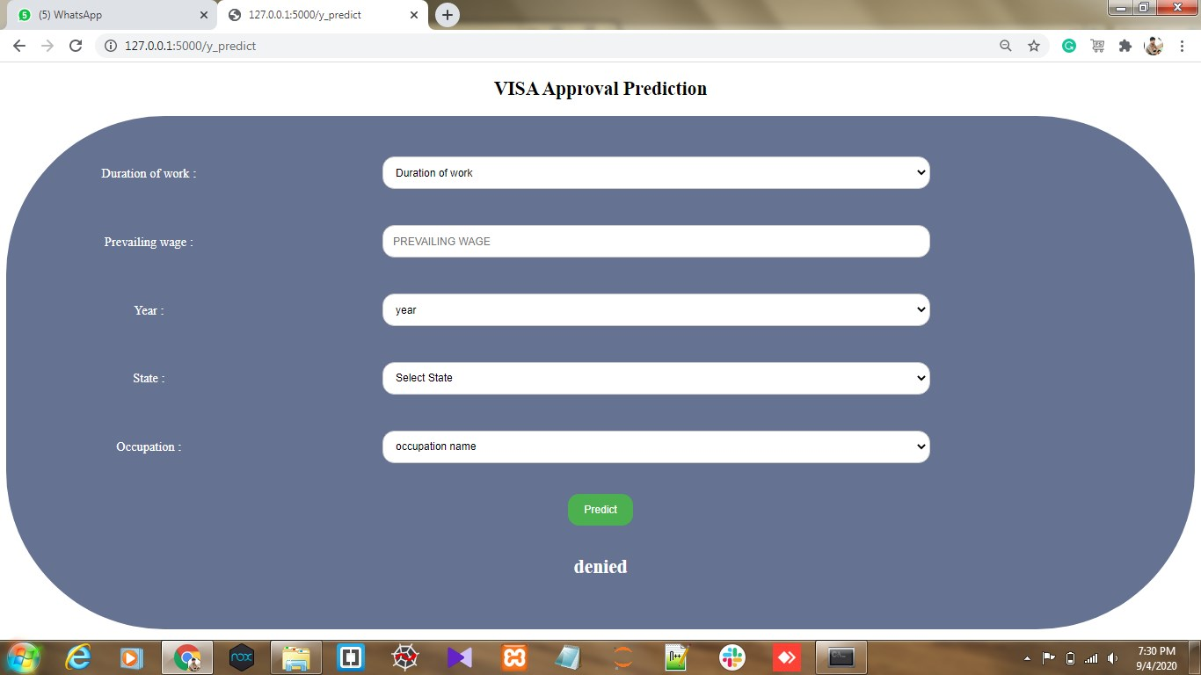
EXPERIMENTAL INVESTIGATION
In this paper, the dataset we used is derived from H-1B_Kaggle .It contains more than 9L H-1B Visa data of users .It contained 7 features and 1 label which can be examined attributesNext step is to build model. After that video streaming will detects the images. Those collection of forest outputs are given below
(a)Predicted as Visa Approval Status Analysis
(b)Program form Visa Approval Prediction

Slide 10
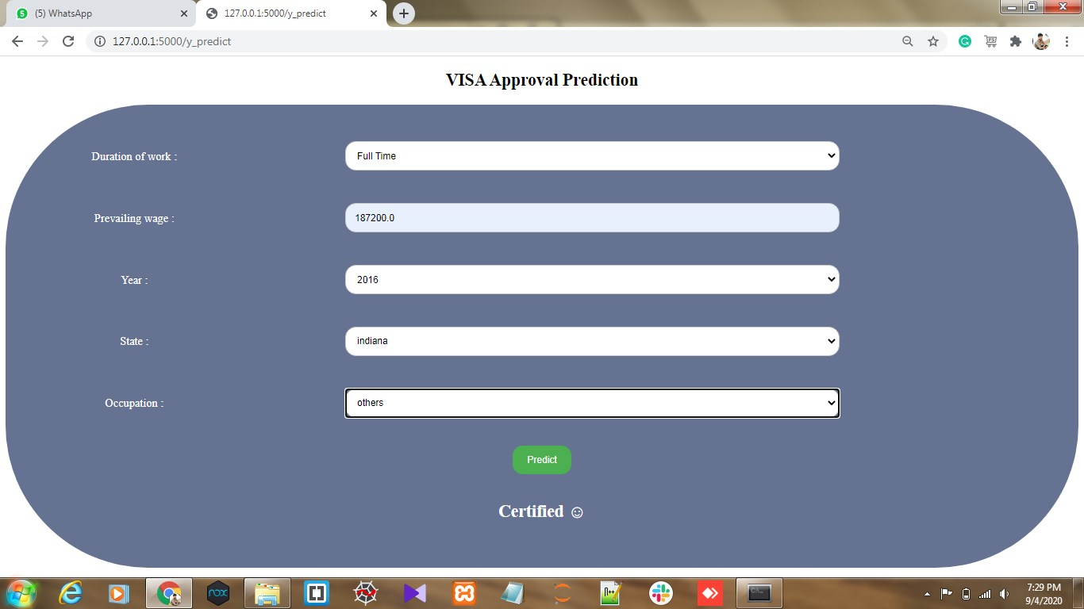

Conti..
(a)Predict when Visa Certified
(b) Predict when Visa Denied

Slide 11
ADVANTAGES
Naive Bayes give the accurate result of the prediction upto 98% which is the algorithm we used for prediction.
H-1B visa benefit ,and perhaps the main reason for its popularity, is the board requirements associated with qualifying for the visa
Duration of Stay
Dual Intent (pursue legal permanent residency) while under H-1B non-immigrant status.
DISADVANTAGE
Lottery.
Extensions.
Due to lottery process,there are strict dates the must be adhgered to during process.

Slide 12
CONCLUSION
Inorder to predict the outcome of H-1B visa applications based on the attributes of the applicant ,several machine learning models like SVM, Naive Bayes can be used. Finally,this can be integrated to a web appliction.
The results show that the proposed algorithm achieves good detection rates. These results indicate that the proposed method is accurate and can be used in Visa Approval.

Slide 13
THANK YOU !

